Slide 1

Predicting Student Grades
Vinh Van

Slide 2
Objective
Using multivariate linear regression analysis, my objective is to predict a student’s grade based on a large variety of variables relating to student demographics, socioeconomic circumstances and school-related factors

Slide 3
Why?
I wanted to see what factors, if any, play a large role in a student’s grades beyond the scope of conventional wisdom on the subject matter such as:
Amount of time spent studying
Attending every class
Prior grades

Slide 4
How did I do it?
Using R as the primary programming language and RStudio as the IDE, I analyzed a dataset of student’s final grades in secondary education. This dataset
Contained 393 unique entries
Had a total of 33 variables
Was acquired from Kaggle
There was no entries with missing values or discarded inputs. Therefore, all 393 entries were maintained.
References:
P. Cortez and A. Silva. Using Data Mining to Predict Secondary School Student Performance. In A. Brito and J. Teixeira Eds., Proceedings of 5th FUture BUsiness TEChnology Conference (FUBUTEC 2008) pp. 5-12, Porto, Portugal, April, 2008, EUROSIS, ISBN 978-9077381-39-7.

Slide 5
Variables
School – student’s school higher – wants to take higher education
Sex – student’s gender internet – Internet access at home
Age – Age of the student romantic – in a romantic relationship
Address – Student’s home address “type” famrel – quality of family relationship(1-5)
Famsize – student’s family size freetime – free time after school (1-5)
Pstatus – parent’s cohabitation status goout – going out with friends(1-5)
Medu – mother’s education Dalc – workday alcohol consumption(1-5)
Fedu – father’s education Walc – weekend alcohol consumption(1-5)
Mjob – mother’s job health – current health status(1-5)
Fjob – father’s job absences – number of school absences(0-93)
Reason – reason to choose schooling G1 – first period grade
Guardian – student’s guardian G2 – second period grade
Traveltime – home to school travel time G3 – final grade
Studytime – weekly study time
Failures – number of past failed classes
Schoolsup – extra educational support
Famsup – family educational support
Paid – extra paid classes within the course subject
Activities – extra-curricular activities
Nursery – attended nursery school

Slide 6
Variables
School – student’s school higher – wants to take higher education
Sex – student’s gender internet – Internet access at home
Age – Age of the student romantic – in a romantic relationship
Address – Student’s home address “type” famrel – quality of family relationship(1-5)
Famsize – student’s family size freetime – free time after school (1-5)
Pstatus – parent’s cohabitation status goout – going out with friends(1-5)
Medu – mother’s education Dalc – workday alcohol consumption(1-5)
Fedu – father’s education Walc – weekend alcohol consumption(1-5)
Mjob – mother’s job health – current health status(1-5)
Fjob – father’s job absences – number of school absences(0-93)
Reason – reason to choose schooling G1 – first period grade
Guardian – student’s guardian G2 – second period grade
Traveltime – home to school travel time G3 – final grade
Studytime – weekly study time
Failures – number of past failed classes
Schoolsup – extra educational support
Famsup – family educational support
Paid – extra paid classes within the course subject
Activities – extra-curricular activities
Nursery – attended nursery school

Slide 7
Dummy Variables
School – student’s school higher – wants to take higher education
Sex – student’s gender internet – Internet access at home
Age – Age of the student romantic – in a romantic relationship
Address – Student’s home address “type” famrel – quality of family relationship(1-5)
Famsize – student’s family size freetime – free time after school (1-5)
Pstatus – parent’s cohabitation status goout – going out with friends(1-5)
Medu – mother’s education Dalc – workday alcohol consumption(1-5)
Fedu – father’s education Walc – weekend alcohol consumption(1-5)
Mjob – mother’s job health – current health status(1-5)
Fjob – father’s job absences – number of school absences(0-93)
Reason – reason to choose schooling G1 – first period grade
Guardian – student’s guardian G2 – second period grade
Traveltime – home to school travel time G3 – final grade
Studytime – weekly study time
Failures – number of past failed classes
Schoolsup – extra educational support
Famsup – family educational support
Paid – extra paid classes within the course subject
Activities – extra-curricular activities
Nursery – attended nursery school

Slide 8
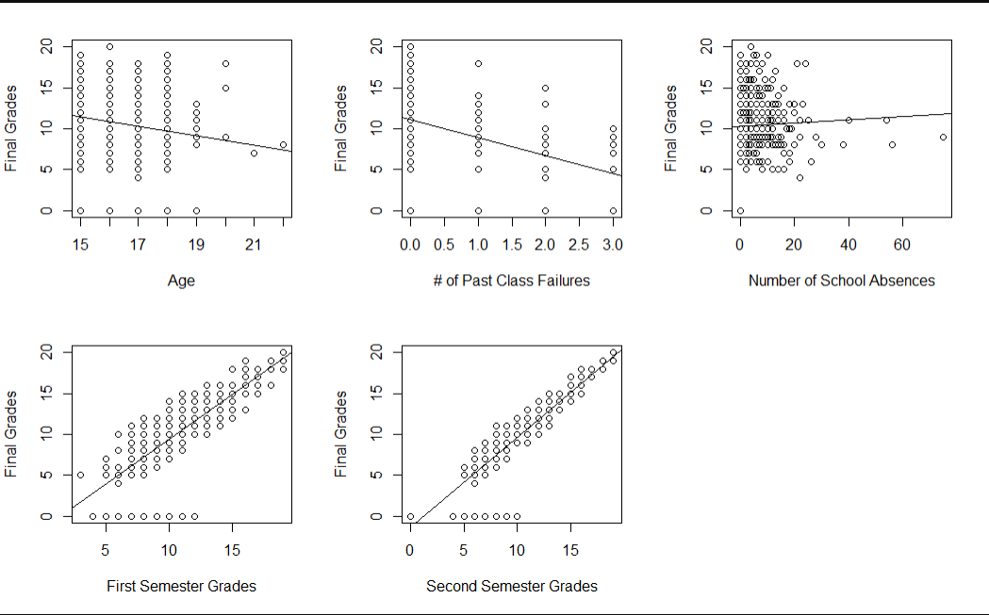
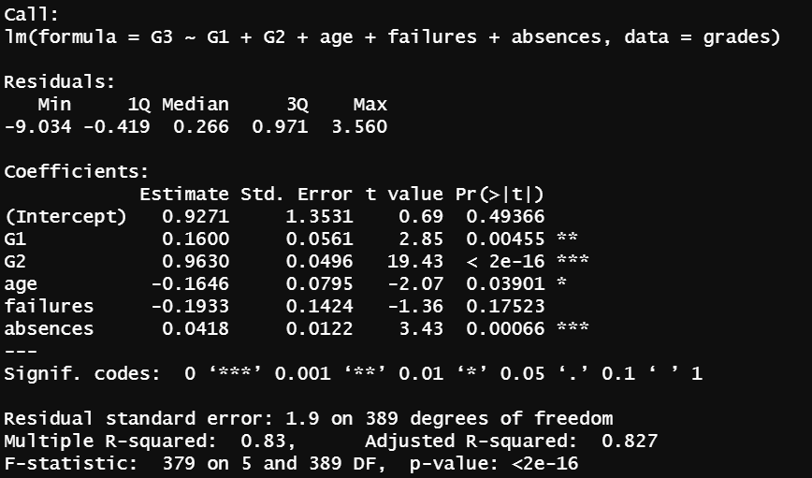
Initial Model
$${\hat{Y}=B}_{0}+B_{1}\left(G1\right)+B_{2}\left(G2\right)+B_{3}\left(Age\right)+B_{4}\left(failures\right)+B_{5}(absences)$$

Slide 9
Collinearity
Creating a Correlation Matrix
 | G3 | G1 | G2 | Age | Failures | Absences
G3 | 1 | 0.801 | 0.905 | -0.162 | -0.360 | 0.034
G1 | 0.801 | 1 | 0.852 | -0.064 | -0.355 | -0.031
G2 | 0.905 | 0.852 | 1 | -0.143 | -0.356 | -0.032
Age | -0.162 | -0.064 | -0.143 | 1 | 0.244 | 0.175
Failures | -0.360 | -0.355 | -0.356 | 0.244 | 1 | 0.064
Absences | 0.034 | -0.031 | -0.032 | 0.175 | 0.064 | 1

Slide 10
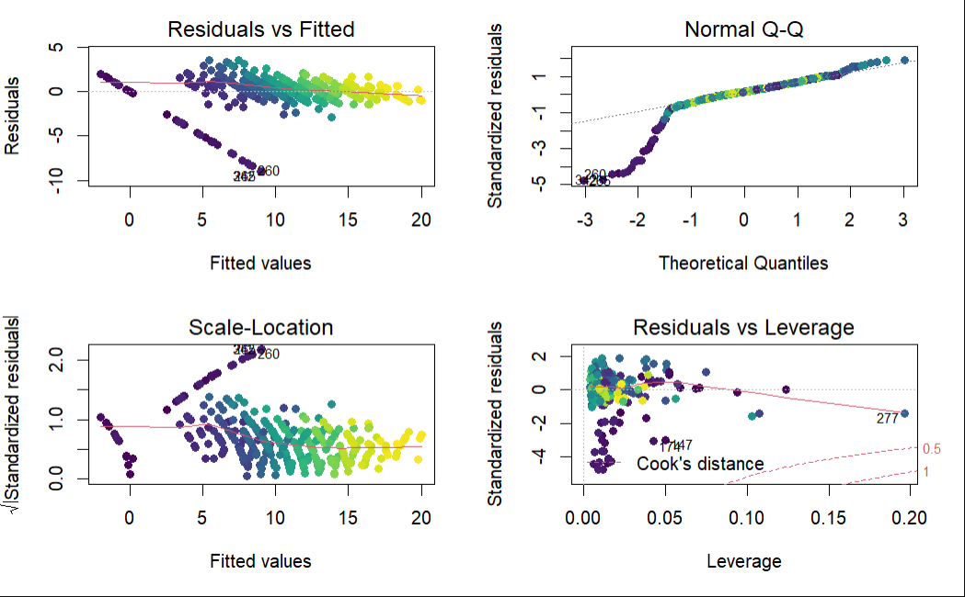
Collinearity
To test for Collinearity, I performed a VIF examination for each of the independent variables with critical value VIF>10
G1 | G2 | Age | Failures | Absences
3.8 | 3.8 | 1.1 | 1.2 | 1.0
Diagnostic Plots

Slide 11
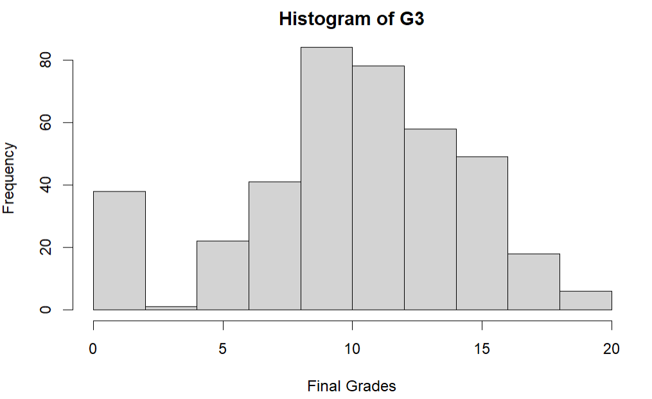
Transforming the Model
G3
Min: 0
1st Quartile: 8
Median: 11
Mean: 10.4
3rd Quartile: 14
Max: 20
We need to transform the model…

Slide 12
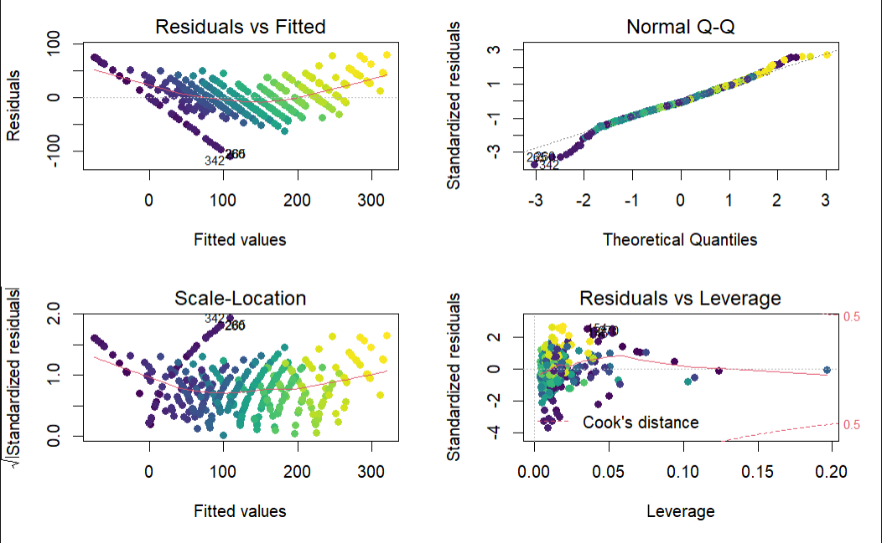
Transforming the Model
I decided to go with a Square transformation because it deals with left-skewedness the best out of all the transformations.
$${{\hat{Y(G3)}}^{2}=B}_{0}+B_{1}\left(G1\right)+B_{2}\left(G2\right)+B_{3}\left(Age\right)+B_{4}\left(failures\right)+B_{5}(absences)$$
Initial Model
Transformed Model

Slide 13
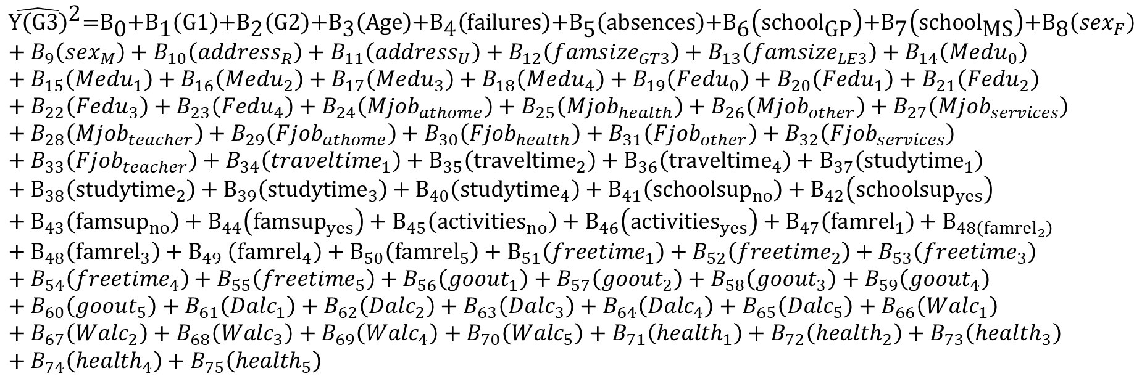
Adding the Dummy Variables
$${{\hat{Y(G3)}}^{2}=B}_{0}+B_{1}\left(G1\right)+B_{2}\left(G2\right)+B_{3}\left(Age\right)+B_{4}\left(failures\right)+B_{5}(absences)$$
Turns into this Full Model
$${{{{{{{{{{\hat{\text{Y}\left(\text{G}\text{3}\right)}}^{\text{2}}\text{=}\text{B}}_{\text{0}}\text{+}\text{B}}_{\text{1}}\left(\text{G}\text{1}\right)\text{+}\text{B}}_{\text{2}}\left(\text{G}\text{2}\right)\text{+}\text{B}}_{\text{3}}\left(\text{Age}\right)\text{+}\text{B}}_{\text{4}}\left(\text{failures}\right)\text{+}\text{B}}_{\text{5}}\left(\text{absences}\right)\text{+}\text{B}}_{\text{6}}\left({\text{school}}_{\text{GP}}\right)\text{+}\text{B}}_{\text{7}}\left({\text{school}}_{\text{MS}}\right)\text{+}\text{B}}_{\text{8}}\left(sex_{F}\right)+B_{9}\left(sex_{M}\right)+B_{10}\left(address_{R}\right)+B_{11}\left(address_{U}\right)+B_{12}\left(famsize_{GT3}\right)+B_{13}\left(famsize_{LE3}\right)+B_{14}\left(Medu_{0}\right)+B_{15}\left(Medu_{1}\right)+B_{16}\left(Medu_{2}\right)+B_{17}\left(Medu_{3}\right)+B_{18}\left(Medu_{4}\right)+B_{19}\left(Fedu_{0}\right)+B_{20}\left(Fedu_{1}\right)+B_{21}\left(Fedu_{2}\right)+B_{22}\left(Fedu_{3}\right)+B_{23}\left(Fedu_{4}\right)+B_{24}\left(Mjob_{athome}\right)+B_{25}\left(Mjob_{health}\right)+B_{26}\left(Mjob_{other}\right)+B_{27}\left(Mjob_{services}\right)+B_{28}\left(Mjob_{teacher}\right)+B_{29}\left(Fjob_{athome}\right)+B_{30}\left(Fjob_{health}\right)+B_{31}\left(Fjob_{other}\right)+B_{32}\left(Fjob_{services}\right)+B_{33}\left(Fjob_{teacher}\right)+B_{34}\left(traveltime_{1}\right)+B_{35}\left({traveltime}_{2}\right)+B_{36}\left({traveltime}_{4}\right)+B_{37}\left({studytime}_{1}\right)+B_{38}\left({studytime}_{2}\right)+B_{39}\left({studytime}_{3}\right)+B_{40}\left({studytime}_{4}\right)+B_{41}\left({schoolsup}_{no}\right)+B_{42}\left({schoolsup}_{yes}\right)+B_{43}\left({famsup}_{no}\right)+B_{44}\left({famsup}_{yes}\right)+B_{45}\left({activities}_{no}\right)+B_{46}\left({activities}_{yes}\right)+B_{47}\left({famrel}_{1}\right)+B_{48\left({famrel}_{2}\right)}+B_{48}\left({famrel}_{3}\right)+B_{49} \left({famrel}_{4}\right)+B_{50}\left({famrel}_{5}\right)+B_{51}\left(freetime_{1}\right)+B_{52}\left(freetime_{2}\right)+B_{53}\left(freetime_{3}\right)+B_{54}\left(freetime_{4}\right)+B_{55}\left(freetime_{5}\right)+B_{56}\left(goout_{1}\right)+B_{57}\left(goout_{2}\right)+B_{58}\left(goout_{3}\right)+B_{59}\left(goout_{4}\right)+B_{60}\left(goout_{5}\right)+B_{61}\left(Dalc_{1}\right)+B_{62}\left(Dalc_{ }\right)+B_{63}\left(Dalc_{3}\right)+B_{64}\left(Dalc_{4}\right)+B_{65}\left(Dalc_{5}\right)+B_{66}\left(Walc_{1}\right)+B_{67}\left(Walc_{2}\right)+B_{68}\left(Walc_{3}\right)+B_{69}\left(Walc_{4}\right)+B_{70}\left(Walc_{5}\right)+B_{71}\left(health_{1}\right)+B_{72}\left(health_{2}\right)+B_{73}\left(health_{3}\right)+B_{74}\left(health_{4}\right)+B_{75}\left(health_{5}\right)$$

Slide 14
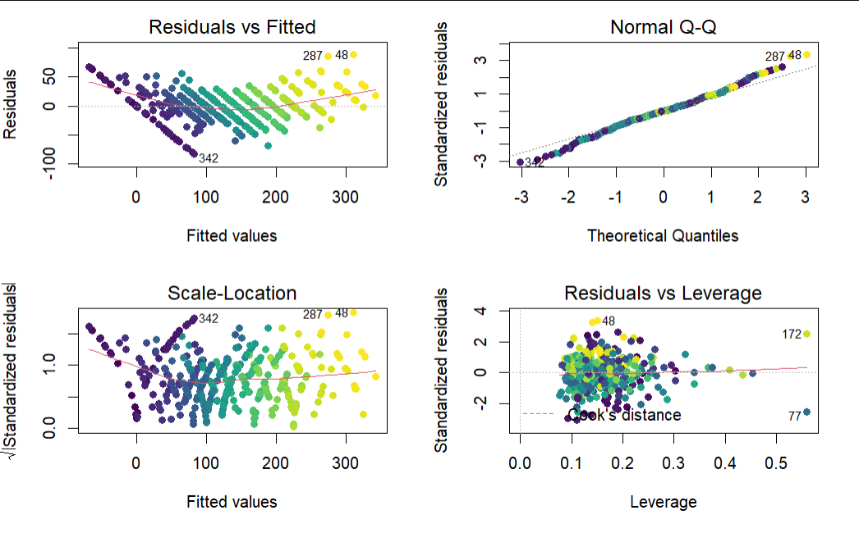
Adding the Dummy Variables

Slide 15
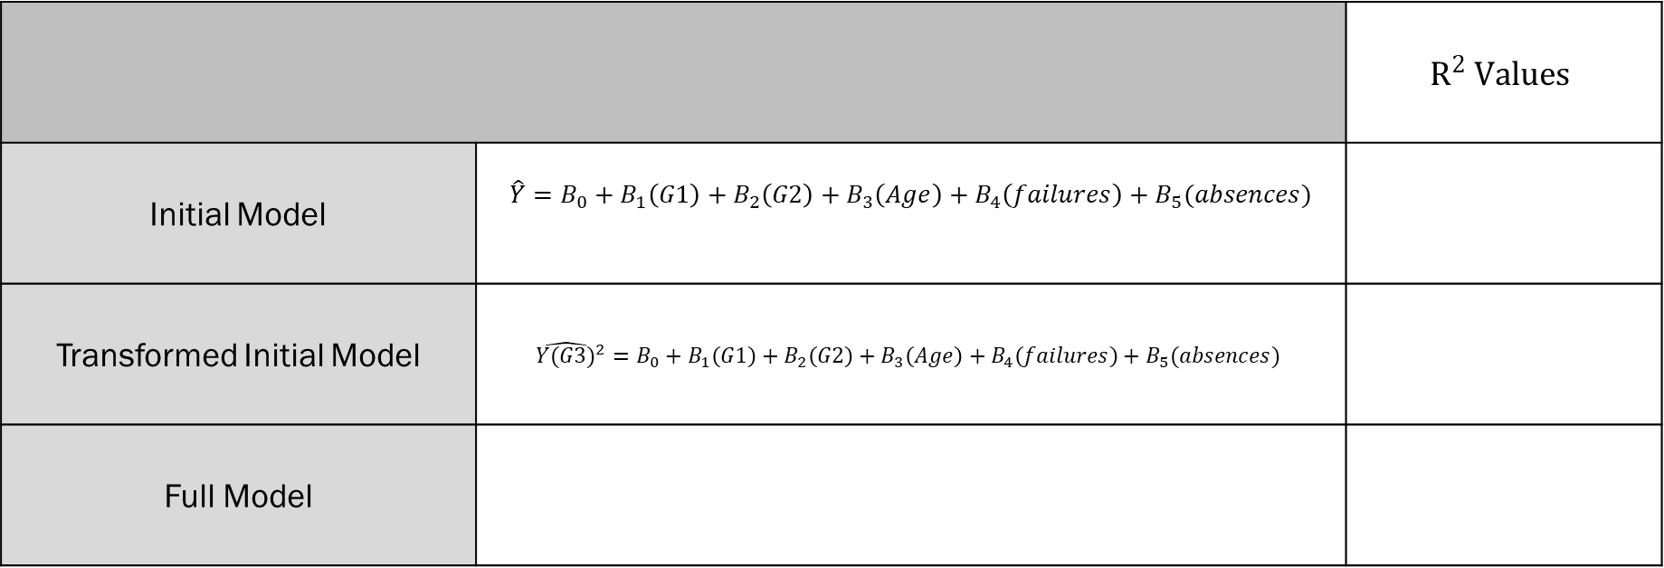
Progress Report
 |  | $$R^{2} Values$$
Initial Model | $${\hat{Y}=B}_{0}+B_{1}\left(G1\right)+B_{2}\left(G2\right)+B_{3}\left(Age\right)+B_{4}\left(failures\right)+B_{5}(absences)$$
Transformed Initial Model | $${{\hat{Y(G3)}}^{2}=B}_{0}+B_{1}\left(G1\right)+B_{2}\left(G2\right)+B_{3}\left(Age\right)+B_{4}\left(failures\right)+B_{5}(absences)$$
Full Model

